Slide 1
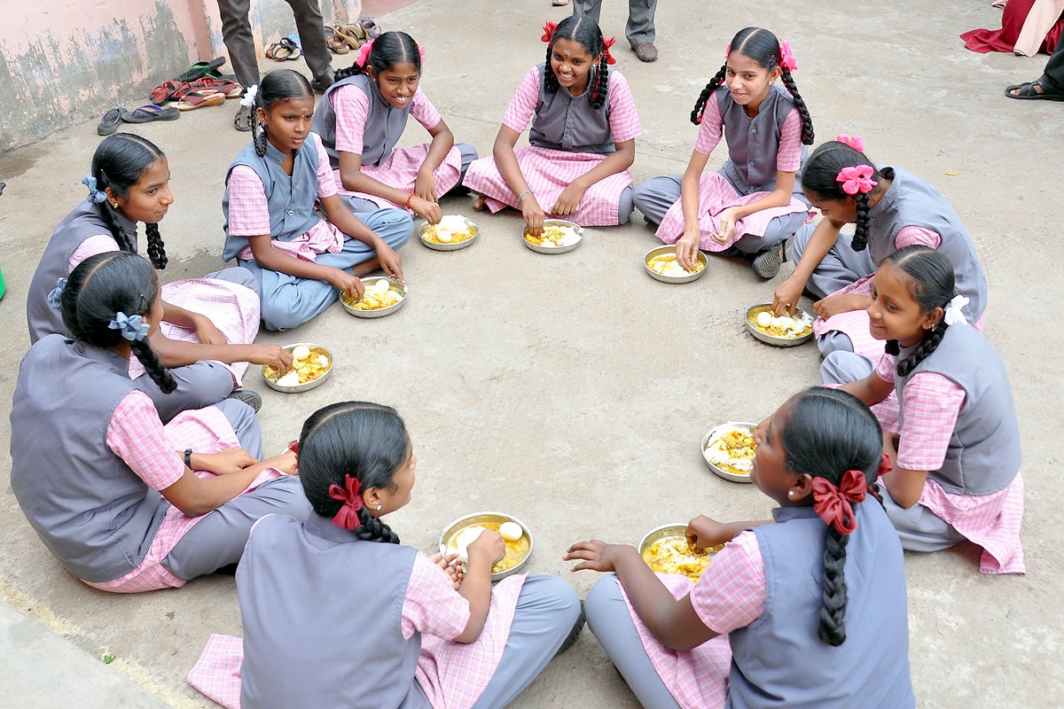
PAB - MDM Meeting for Review of Implementation of MDMS in Tamil Nadu on 16.05.2019
Mid Day Meal Scheme

Slide 2
Coverage of Children (Primary & U. Primary)
Children (Primary) |  |  |  | Children (Upper Primary)
State | PAB Approval | Coverage | % | PAB Approval | Coverage | %
Tamilnadu | 25,28,269 | 24,72,071 | 98% | 20,14,484 | 19,69,357 | 98%
Ministry of HRD, Govt. of India

Slide 3
Working Days (Primary & U. Primary)
State | Working Days (Pry) |  |  | Working Days (U.Pry)
 | PAB Approval | Coverage | % | PAB Approval | Coverage | %
Tamilnadu | 210 | 210 | 100% | 220 | 220 | 100%
Ministry of HRD, Govt. of India

Slide 4
Engagement of Cook-cum-Helpers (Primary & U. Primary)
State | PAB Approval | Coverage | %
Tamilnadu | 1,28,130 | 1,28,130 | 100%
Ministry of HRD, Govt. of India

Slide 5
Procurement of Kitchen Devices
(Primary & U. Primary)
State | Sanctioned | Procured | %
Tamilnadu | 95,579 | 95,579 | 100%
Ministry of HRD, Govt. of India

Slide 6
Construction of Kitchen-cum-Stores
(Primary & U. Primary)
State | Sanctioned | Constructed | %
Tamilnadu | 28,470 | 27,792 | 99%
Ministry of HRD, Govt. of India

Slide 7
Performance Grading Index (PGI)
Performance Grading Index (PGI):
Score against the weightage of 10 for indicator No. 1.3.7 i.e. “% of elementary school’s children taking MDM against target approved in PAB – in Govt. and aided schools”.
Score against the weightage of 10 for indicator No 1.3.8 i.e. “% of days Mid Day Meal served against total working days – Govt. and aided elementary schools.”
State | Score (children taking MDM) (1.3.7) out of 10 | Score (MDM served days ) (1.3.8) out of 10
Tamilnadu | 10 | 10
Ministry of HRD, Govt. of India

Slide 8
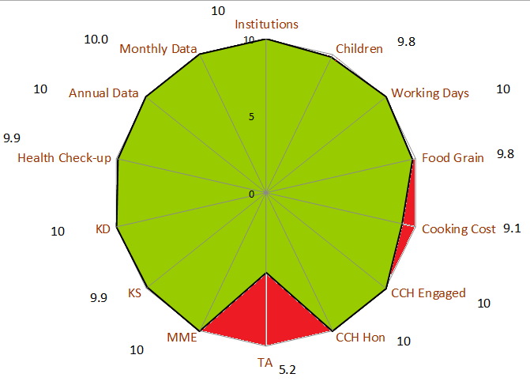
Performance Score Card - Tamilnadu
Component | PAB-Approval | Achievement | % Achievement
Institutions | 43283 | 43283 | 100%
Children | 4542753 | 4441428 | 98%
Working Days | 215 | 215 | 100%
Food Grain Utilisation (in MTs) | 119884.66 | 117187.46 | 98%
Cooking Cost (Rs. in Lacs) | 72742.63 | 65899.78 | 91%
CCH Engaged | 128130 | 128130 | 100%
CCH Honorarium (Rs. in Lacs) | 13838.04 | 13838.04 | 100%
TA (Rs. in Lacs) | 899.13 | 470.57 | 52%
MME (Rs. in Lacs) | 782.11 | 782.11 | 100%
Kitchen cum Store | 28470 | 27792 | 99%
Kitchen Devices | 95579 | 95579 | 100%
No. of Children's Health Check-up | 5010783 | 4961672 | 99%
Annual Data Entry | 43283 | 43283 | 100%
Monthly Data Entry | 43283 | 43283 | 100%
Ministry of HRD, Govt. of India

Slide 9
School Nutrition Gardens
.
Focus of this Year
Convergence
with line departments
The grown whole vegetables, fruits can be consumed. Some of the parts like stem (banana, bottle gourd, pumpkin) leaves (coriander, mint, spinach), flower (pumpkin flower, morringa).
Funds for School Nutrition Garden
Krishi Vigyan Kendras, Department of Agriculture/Horticulture, Food & Nutrition Board, State Agriculture Universities etc.
School Nutrition Garden
Where School Nutrition Garden can be set up?
Objectives
SNG is a place where herbs, fruits and vegetables are grown in the school premises for use in preparation of Mid-Day Meal.
To help address malnutrition and micro nutrient deficiencies
What part of plants can be eaten
Plants may also be grown in small containers, cans, jars, discarded earthen pots, wooden peti, ceramic sinks, food tins, and atta bags etc, where land is not available.
Large piece of land is not required even roof tops can be used for growing vegetable/fruits in containers.
The leaves, fruits/vegetables and stems of some plants like bottle gourd (lauki), pumpkin (kaddu) etc can be consumed
To give children first-hand experience with nature and gardening.
Rs 5000/- per School Nutrition Garden from flexi funds.
District Level Committee may allot funds on school specific requirement, within the overall average of Rs 5000/- per SNG.
Boundary wall, leveling of land etc can be take up under MGNREGA.
Seeds/saplings from Agriculture/horticulture department

Slide 10
Focus of this year - Cooking Competition
Funds for Cooking competition
Who can participate
Who will be the Judges
Identification of the activities to be carried out
All the Cook cum helpers, interested community members.
Cooking of pulses/cooking of vegetables/different types of chapattis,
Recognition of cook cum helpers
Children (2 children each from primary and upper primary classes) and nutritionists (Home Science College/UNICEF) of that block/district may be selected.
Methods of cooking/methods of washing vegetables,
Food safety issues, hand washing etc.
The winning Cook-cum helpers/community members may be awarded suitably.
Expenditure may be met from MME funds.
Ministry of HRD, Govt. of India

Slide 11
Focus of this year
Usage of Temples, Gurudwaras, Jails etc. for Mid Day Meal:
Temples, Gurudwaras, Jails etc. can be involved in Mid Day Meal Scheme.
Temples, Gurudwaras have greater reach among community, this can help in wider publicity for Mid Day Meal Scheme.
Temples, Gurudwaras can adopt some schools for providing meals.
Enhanced sense of ownership of the Mid Day Meal Scheme among the local community.
Uploading of videos, testimonials on Shagun web-portal:
Shagun web-portal is an innovation for repository of best practices which collates videos, testimonials, case studies and images of state-level innovations and success stories.
Accordingly, relevant videos, testimonials of the innovative activities being carried out by States/UTs related to Mid Day Meal may be shared with this department so that the same may be uploaded on Shagun (https://repository.seshagun.nic.in) repository after necessary approvals.
Ministry of HRD, Govt. of India

Slide 12
Focus of this year
Tithi Bhojan
Tithi Bhojan, is a community participation programme initiated by Gujarat.
Community provides full meal or additional items on special occasions, birthdays, marriages, anniversaries, days of national importance and other festivals etc.
Guidelines issued on Tithi Bhojan on 26th October, 2018.
Tithi Bhojan has been adopted by the States & UTs of Assam (Sampriti Bhojan), Andhra Pradesh, Punjab (Priti bhojan), Dadra & Nagar Haveli (Tithi Bhojan), Daman & Diu (Tithi Bhojan), Karnataka (Shalegagi Naavu Neevu), Madhya Pradesh, Maharastra (Sneh Bhojan), Chandigarh (Tithi Bhojan), Puducherry (Anna Dhanam), Haryana (Beti ka Janamdin), Tamil Nadu (Tithi Bhojan) and Uttarakhand (Tithi Bhojan).
Ministry of HRD, Govt. of India

Slide 13
Focus of this year
Ministry of HRD, Govt. of India

Slide 14
Automated Monitoring System
1
AMS is used to monitor MDMS on real time basis.
2
Schools need to share the daily data on number of meals and reasons if meals are not served.
3
States/UTs are using various technologies (SMS/ IVRS/ Mobile App) for daily data collection.
Graphical dashboard: Reports are generated and displayed online
4
5
Drill down reports from State to school level are available
6
Daily email alerts are sent to States and UTs level regarding implementation of AMS.
Ministry of HRD, Govt. of India

Slide 15
Status of implementation of MIS & AMS

Slide 16
Centralized Kitchens only in Urban Areas
The National Food Security Act, 2013 and MDM Rules, 2015 (as amended on 16th April, 2019) provide that :
“Every school shall have the facility for cooking meal in hygienic manner. Schools in urban areas may use the facility of centralized kitchens for cooking meals wherever required in accordance with the guidelines issued by the Central Government and the meal shall be served to the children at respective school only”
Ministry of HRD, Govt. of India

Slide 17
Social Audit
Social Audit is collective monitoring of a scheme by people’s active involvement.
It covers the issues of equity and equality along with expenditure in programme implementation.
The Social Audit Units setup under MNREGS, may be actively involved in conducting Social Audit of MDM in all districts.
Key Features and Benefits:
It informs and educates people about their rights and entitlements.
It provides a collective platform for people to ask queries, express their needs and grievances.
It promotes people's participation in all stages of implementation of programme.
It brings about transparency and accountability in Government schemes.
It strengthens decentralised governance.

Slide 18
Status of Flow of Funds from State to School
Name of State | Timely release of fund from State to District / School
Tamilnadu | Timely
Ministry of HRD, Govt. of India

Slide 19
PAB Recommendations of Central Assistance
(Rs. in Lakhs)
S. No | State | PAB Approval for FY 2018-19 | Proposal for FY 2019-20 | PAB Recommendations for FY - 2019-20
1 | Tamilnadu | 42624.01 | 44980.98 | 44980.98

Slide 20
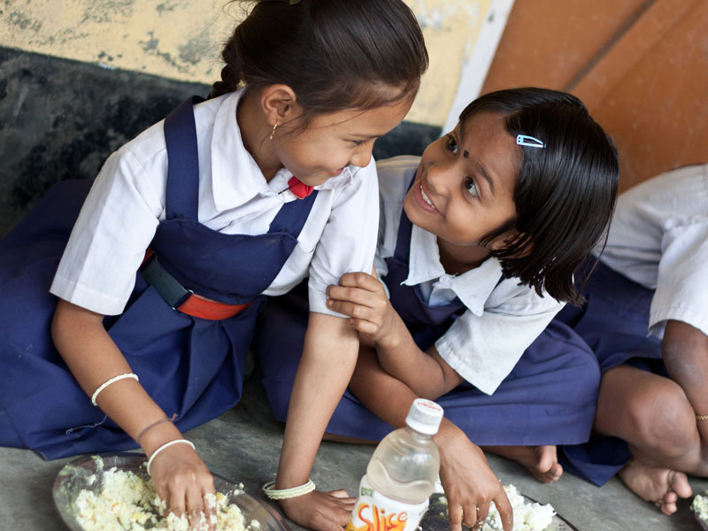
A meal to a Child is an offering to the Divinity.
Thank You

Slide 21
Tamilnadu : Proposals and Recommendations
S. N | Component | PAB Approval 2018-19 | Proposal for 2019-20 | Recommendation 2019-20
1 | Children (Pry) | 2528269 | 2425043 | 2425043
2 | Children (U Pry) | 2014484 | 1932627 | 1932627
3 | Children (NCLP) | 6689 | 5530 | 5530
4 | Working Days – Pry | 210 | 210 | 210
5 | Working Days – U Pry | 220 | 220 | 220
6 | Working Days – NCLP | 312 | 312 | 312
7 | Cook cum Helper | 128130 | 128130 | 128130
8 | Drought | Nil | Nil | Nil
9 | Kitchen cum Store | Nil | Nil | Nil
10 | Kitchen-cum-store (Repair) | NA | 2167 | 2167
11 | Kitchen Devices (New) | 0 | 0 | 0
12 | Kitchen Devices (Rep.) | 0 | 6319 | 6319
13 | School Nutrition Gardens | NA | 10024 | 10024
Central Assistance (Rs in Lakh) |  | 42624.01 | 44980.98 | 44980.98
Back to slide

